Slide 1
Cross-Platform Mobile Application Development with Xamarin
Module 3, Lesson 2:
Understanding Xamarin
Notes:
Images and excerpts from Xamarin Mobile Application Development by Dan Hermes, published by Apress
http://www.mobilecsharpcafe.com/xamarin-book/

Slide 2
Topics
Xamarin history
The Xamarin approach to cross-platform mobile development
Basic Xamarin concepts

Slide 3
Objectives
In this lesson you will learn about:
What Xamarin is
The Xamarin approach
Xamarin fundamentals

Slide 4
What is Xamarin?

Slide 5
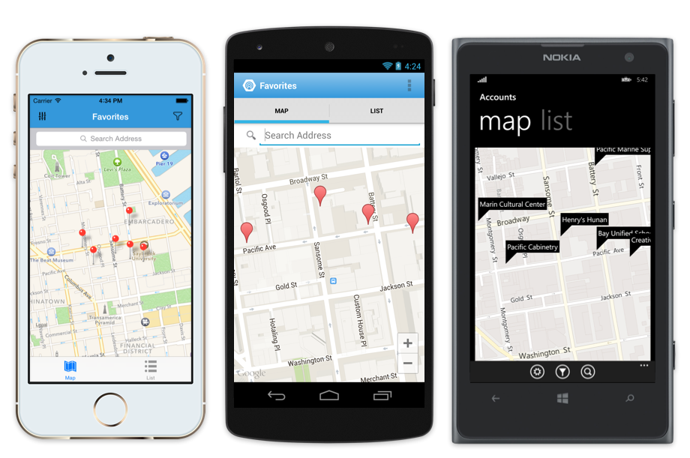
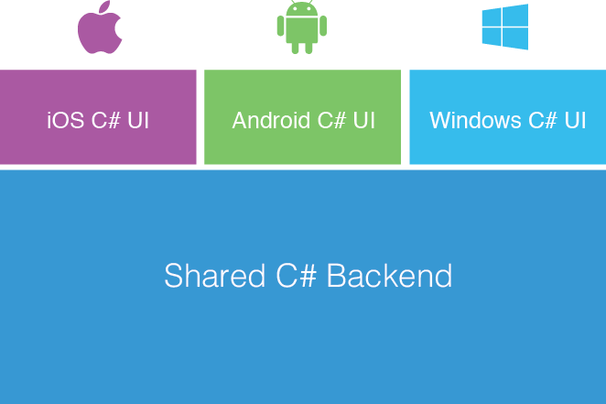
Xamarin’s Approach
Fully native apps written entirely in C#
Xamarin delivers fully native user interfaces and app functionality
Complete access to 100% of the native APIs for iOS, Android and Windows in C#
Share app logic and UI code across device platforms
Shared App Logic in C#
Notes:
References:
Image courtesy of Xamarin

Slide 6
Xamarin Background
Cross-platform mobile development framework that uses C#
Compiles to respective native executables
{ }
{ }
{ }
iOS
C# UI
Android
C# UI
Windows
C# UI
Xamarin Approach
Native with Code Sharing
Shared C#
Notes:
Notes:
Benefits of C#:
Object-oriented, type-safe programming language
Developed by Microsoft, released in 2000
Became an ECMA standard in 2002
Syntactically similar to C and C++
References:
C# introduction from Microsoft: https://msdn.microsoft.com/en-us/library/aa645597(v=vs.71).aspx
Object-oriented programming: https://en.wikipedia.org/wiki/Object-oriented_programming
Type safety: https://en.wikipedia.org/wiki/Type_safety
ECMA standardization: http://www.ecma-international.org/publications/files/ECMA-ST-WITHDRAWN/ECMA-334,%202nd%20edition,%20December%202002.pdf

Slide 7
Xamarin History: Mono
Event | Result/Implication
Miguel de Icaza of Ximian founded Mono project | Brought C# compiler and CLR to Linux
Follows the ECMA standard for C# | Compiles C# code, maps to native Linux calls
Mono for Android | Maps C# code to native Android calls
MonoTouch (for iPhone) | Maps C# code to native iPhone calls
Notes:
Notes:
Following the ECMA standard allows for the reading of C# code and interpreting it for any platform.
References:
Xamarin history reference: https://en.wikipedia.org/wiki/Xamarin#History
Mono history reference: https://en.wikipedia.org/wiki/Ximian#History

Slide 8
Xamarin History: Founding
Event (Year)
Ximian acquired by Novell (2003)
Novell acquired by Attachmate in (2011)
de Icaza founded Xamarin to continue/expand Mono project (2011)
Notes:
References:
Xamarin history reference: https://en.wikipedia.org/wiki/Xamarin#History
Mono history reference: https://en.wikipedia.org/wiki/Ximian#History

Slide 9
Xamarin History: Establishment
Event (Year) | Results/Implications
Xamarin.Mac (2012) | Maps C# code to OS X
Xamarin 2.0 Announced (2013) | Xamarin Studio IDE Visual Studio plugin MonoTouch becomes Xamarin.iOS Mono for Android becomes Xamarin.Android
Xamarin Acquired by Microsoft (2016) | Included in MSDN subscription Xamarin Studio Community Edition (free)
Notes:
Notes:
After its acquisition, Microsoft folded Xamarin into the Microsoft ecosystem.
Xamarin is included for free in Microsoft Developer Network (MSDN) subscriptions.
MSDN subscriptions allow subscribers to download and install most Microsoft software.

Slide 10
The Xamarin Approach

Slide 11
Xamarin Approach
Makes the app as native as possible
Binds C# code to native platform API calls
Each app ships with subset of .NET language to perform shared logic
Follow established ECMA standard
Other Approaches:
Native shell, JavaScript logic
Host a locally-installed website in a native browser (WebView)
Notes:
Notes:
Cross-platform mobile frameworks do not necessarily support all phones.
Obscure device features often not supported.
Some frameworks are very close to native in their performance, while others are not.

Slide 12
Xamarin Approach
Xamarin supports F#
F# is a strongly-typed, functional, imperative programming language
Designed to run on .NET
Made possible since Xamarin supports the core .NET libraries
Notes:
References:
https://developer.xamarin.com/guides/cross-platform/fsharp/

Slide 13
Xamarin Approach
As much shared code as possible
As little platform-specific code as needed
As much shared code as possible
As little platform-specific code as needed
Combine data access layer and business logic into shared code
Consider Xamarin.Forms vs. Platform-specific approaches
Xamarin.Forms allows UI code sharing
Platform-specific approach provides greater access to OS UI APIs
Notes:
Notes:
Backend is mostly shared code, though some platform-specific backend code may be necessary.
UI code can be shared with Xamarin.Forms (explained in a later lesson). Otherwise, the UI code is platform-specific.
Code reuse among the UIs is achievable and will also be explained later.

Slide 14
Xamarin Platform-specific App Architecture
Using Xamarin.iOS and Xamarin.Android platform-specific UI
Platform-specific UI code in C#, XAML, XML, Storyboards, and XIBs
Shared app logic code in C#
100% access to OS UI APIs
Good for apps with sophisticated UX requirements (complicated gestures, animations, design)
iOS
UI
Android
UI
Windows
UI
Shared C#
Notes:
Notes:
Platform-specific is sometimes called Traditional architecture, and uses Xamarin.Android or Xamarin.iOS.

Slide 15
Xamarin.Forms App Architecture
Increase Code Sharing Up to 100% and Deliver a Fully Native App
Shared in C# or XAML
Shared app logic code in C#
Mix-and-Match the use of Xamarin.Forms with platform-specific code
Good for forms-based apps with a lot of data entry screens
Easy to learn API makes you productive immediately, without platform-specific knowledge
Xamarin.Forms
Native
iOS
App
Native
Android App
Native
Windows App
Shared App Logic
Shared C# UI Code
Shared C# App Logic

Slide 16
Xamarin App Architectures
Native
iOS App
Native
Android App
Native
Windows App
iOS
C# UI
Android
C# UI
Windows
C# UI
iOS C# UI
Android C# UI
Shared C#/XAML UI
Shared C#
Shared C# App Logic
Shared App Logic
Platform-specific
Xamarin.Forms

Slide 17
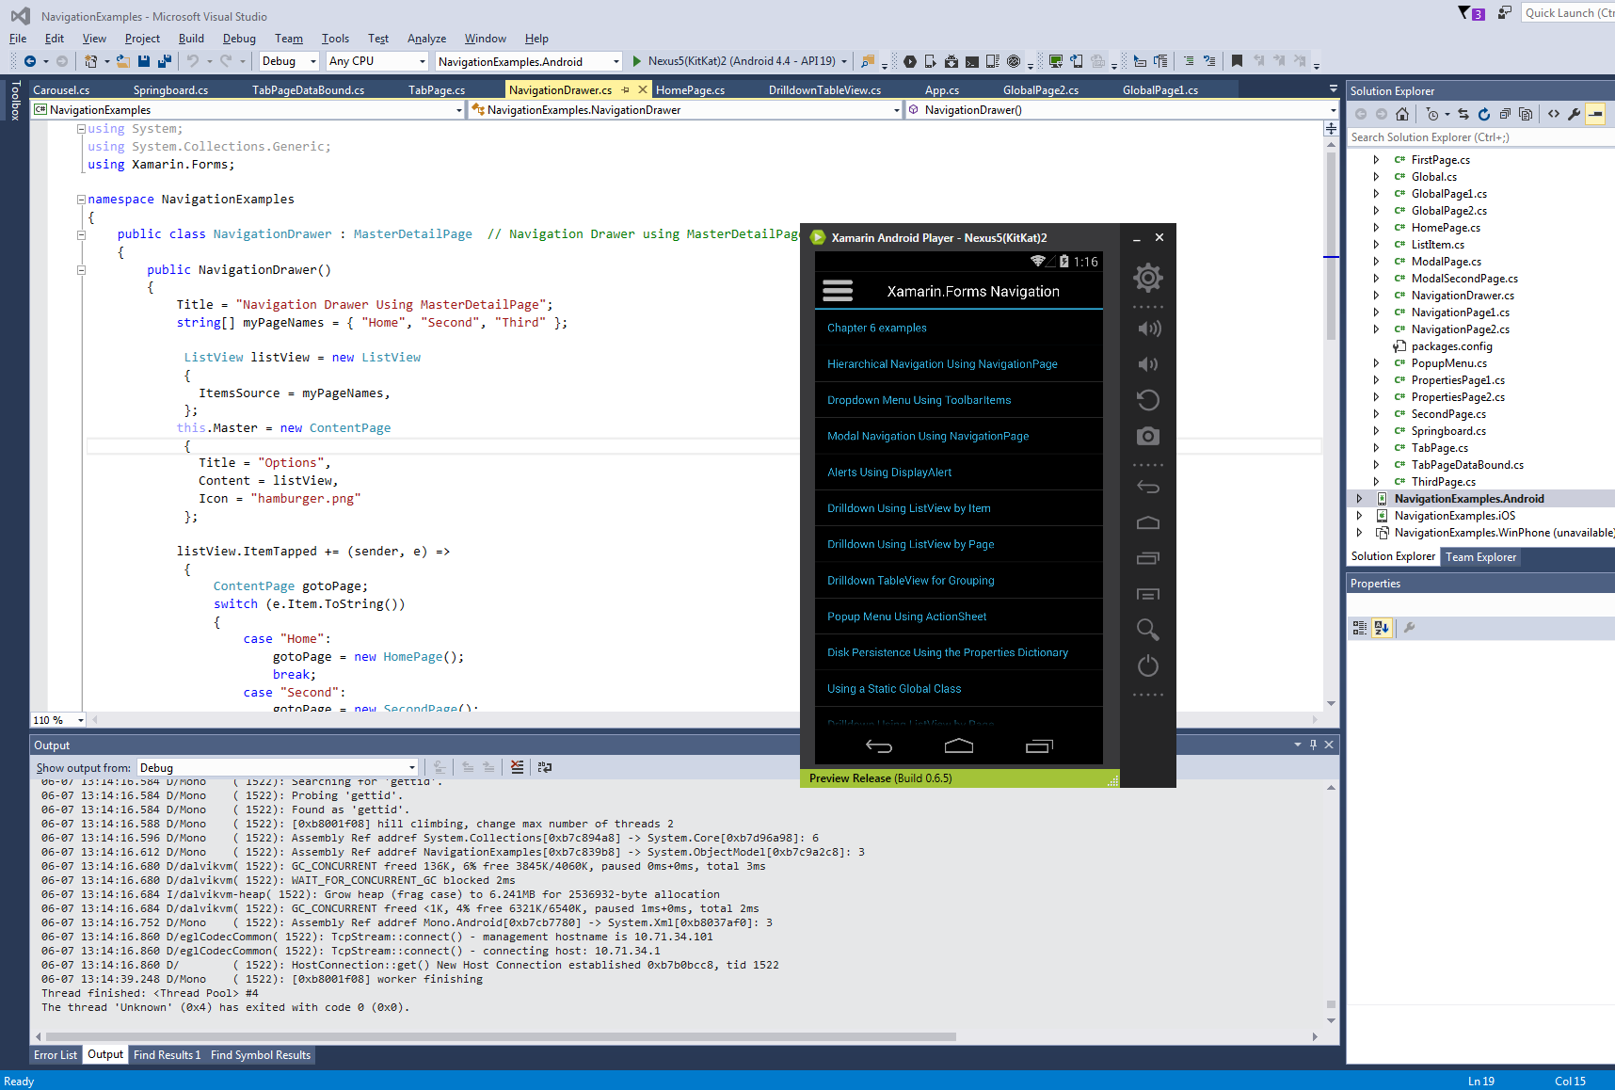
Visual Studio with Xamarin Plug-in
Notes:
Notes:
Xamarin is free with all versions of Visual Studio, even the free Community Edition.
Android Player is also included in this image. Downloaded separately (but free).
References:
Image from Xamarin Mobile Application Development by Dan Hermes http://amzn.to/1rowG7K

Slide 18
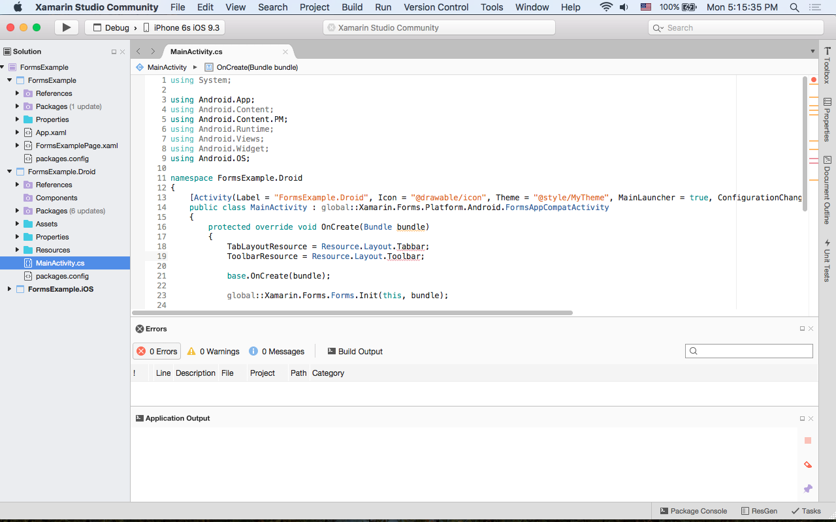
Xamarin Studio
Notes:
Notes:
Xamarin Studio is available for both Mac and PC
Pictured here on a Mac

Slide 19
Basic Xamarin Concepts

Slide 20
Xamarin Platform
The Xamarin platform is a collection of bindings around SDKs
Xamarin provides the core functionality of .NET using C#
Xamarin.Android binds to the Android SDK
Xamarin.iOS binds to the iOS UIKit
Xamarin.Forms binds to Xamarin.Android, Xamarin.iOS,
and Windows SDK
Notes:
Notes:
Maximize Code Reuse whenever possible.
Encapsulation: Exposing a minimal interface of an object to describe interaction points while hiding implementation details.
Separation of concerns (SoC): A design principle that involves separating code based on concerns.
Concerns could be something as generic as user interface or data access, or as specific as different kinds of similar objects.

Slide 21
Xamarin.Forms Runs on UWP
Xamarin.Forms with a UWP project runs on these platforms
Windows 10 phones and tablets
Windows 10 PCs
Xbox
HoloLens
Notes:
Notes:
Xamarin.Forms with UWP gives us the Windows 10 phones and desktops
Windows 8 and 8.1 phones still work with Xamarin.Forms but require a Windows 8 Phone project type (not a UWP project).

Slide 22
Xamarin APIs and Native SDKs
Xamarin
Xamarin.Forms
Xamarin.iOS
Xamarin.Android
iOS UIKit
Android SDK
Windows
SDK
Notes:
References:
Image reinterpreted from Xamarin Mobile Application Development by Dan Hermes http://amzn.to/1rowG7K

Slide 23
Code Reuse
One main benefit of cross-platform mobile development
Maximize Code Reuse whenever possible:
Saves time and money
Promotes good programming practices:
Encapsulation
Separation of concerns (SoC)
Notes:
Notes:
Maximize Code Reuse whenever possible.
Encapsulation: Exposing a minimal interface of an object to describe interaction points while hiding implementation details.
Separation of concerns (SoC): A design principle that involves separating code based on concerns.
Concerns could be something as generic as user interface or data access, or as specific as different kinds of similar objects.

Slide 24
Application Architecture
iOS
UI
Android
UI
Windows
UI
Isolate and minimize platform-specific code
Abstract platform-specific logic
Separate, platform-specific implementations
API/UI layers
Reuse data access, business logic, and back end web and data services
Most or all of this code should be reusable
Reusable UI Code
Reusable Business Logic
Reusable Data Access Code
Backend Data Services
Notes:
Notes:
Determine what code needs to call platform APIs and isolate it.
Create parent interfaces or abstract classes to define protocols for platform-specific implementations.

Slide 25
Summary
In this lesson, you have learned:
What Xamarin is
The Xamarin approach
Xamarin fundamentals

